Slide 1


SAP CLOUD APPLICATION PROGRAMMING AND XSA TRAINING IN BPT
Anubhav Oberoy
Day – 2

Slide 2

Agenda – Day 2
Introduction to Views in SAP CAP
Why we need Views.

Slide 3
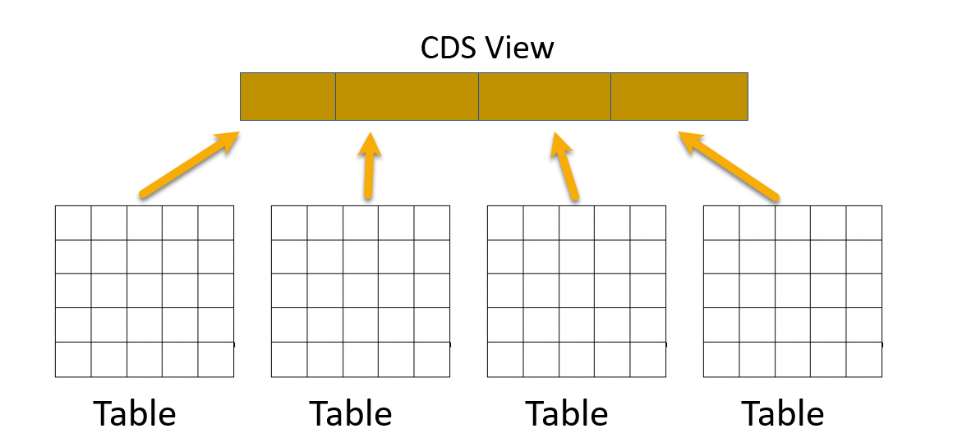
Introduction to Views in SAP CAP
Core Data Service (CDS) Views are virtual data models of SAP HANA which allows direct access to underlying tables of the HANA database.
SAP CDS Views aim to push logic from the application server to the client-side and database. This is defined by SAP as ‘Code -to-Data’ or ‘Code Pushdown’.
CDS Views is an important technology for modern application development on SAP systems and should not be overlooked. They provide enhancements in terms of data modelling and enable improved performance when combined with SAP HANA database.
CDS Views allow developers to create semantically rich data models which the application services expose to UI clients.
While the data in SAP is still physically stored in transparent tables, CDS Views are an abstraction layer on top of the tables for data modelling purposes. They understand the relationship between database tables and hide the complexity from the programmer.

Slide 4
Why we need views in a software
They display non-normalized data. The data is spread in multiple tables, and it is difficult for developers to every time write JOINs.
The application needs data which is presentable to user
View gives security because users cannot update data using view
They can aggregate data like find total sales per customer.
Expose columns of technical type to more semantic names
Syntax of defining Views
Use the as select from variant to use all possible features an underlying relational database would support using any valid CQL query including all query clauses.
Case Insensitive Naming of the View
Case Sensitive Naming of the View
define view ViewName as
select from table{
};
define view! [ViewName] as
select from table{
};

Slide 5
Exercise – Basic CDS View
In this exercise we will create our first CDS View which will expose the non-normalized data for purchase order and purchase order items in combined form. We will expose this view using a new service named CDSService.
Exercise code/resource:
CDSViews.cds
CDSService.cds

Slide 6
Exercise – Advance CDS View
As we have seen the concept of views in SAP CAP. Now we will create some more views to understand the some advance concepts like creating Value Helps and View on View concept and expose them.
Exercise code/resources:
CDSViews.cds
CDSService.cds

Slide 7
Title
Content

Slide 8
Title
Content

Slide 9
Title
Content

Slide 10
Title
Content

Slide 11

End of Day 2

Slide 12

Questions

Slide 13

Anubhav Oberoy

Slide 14


We’re committed to empower you to be
Most Desirable Resource
through powerful training solutions.
We build the workforce of the future.
250+
Corporate Clients
30,000+
Learners Trained
25000+
Learners Placed
FREE WEBINARS
Sign up for free webinars with industry experts every fortnight!
Enroll Now!
Contact us today!
https://anubhavtrainings.com/

Slide 15




More from AnubhavTrainings.com

Slide 16
Title
Content

